Slide 1

Intro to AWS Cloud Development Kit
Elad Ben-Israel
Principal Software Engineer
Amazon Web Services

Slide 2



Floor28 Agenda
Big Data Day
14 Oct
ML & DL Day
15 Oct
DevOps Day
16 Oct
DevOps Day
17 Oct
Databases Day
18 Oct
Technical Sessions
Serverless Data Workshop
Big Data UG Meetup
Technical Sessions
SageMaker Workshop
ML&DL Meetup
Technical Sessions
K8s Workshop
DevOps Meetup
Technical Sessions
Spot Workshop
Technical Sessions
PyTorch Meetup
Builders Day Serverless backend
21 Oct
Builders Day
AppSync, Alexa & IoT
22 Oct
Enterprise IT Day
23 Oct
GameDay
24 Oct
Technical Sessions
Serverless Workshop
Virtual assistants UG Meetup
Technical Sessions
CDK Workshop
AWS IL UG Meetup
Technical Sessions

Slide 3
About me
Elad Ben-Israel Principal Software Engineer AWS Developer Tools & SDKs
Unexplainable desire to write code since I’m about 10
Unexplainable joy from creating tools and SDKs for developers
4 years with Amazon (London, San Francisco and now Tel-Aviv)
Prime Air, Amazon Product Search and now AWS SDKs and Tools
benisrae@amazon.com
Twitter: @emeshbi
GitHub: eladb
👋

Slide 4
Today
The evolution of reproducible infrastructure (15min)
Introducing the AWS CDK and the AWS Construct Library (10min)
Workshop (2.5hrs)
Debrief and Q&A (10min)

Slide 5
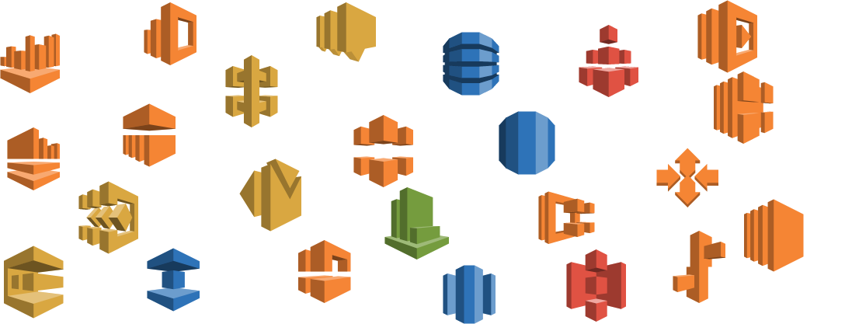
Modern cloud applications have lots of “bits”

Slide 6
Modern cloud applications have lots of “bits”…

Slide 7
Use the console?
Time consuming
Hard to audit
Error prone
Not reproducible
Manual

Slide 8
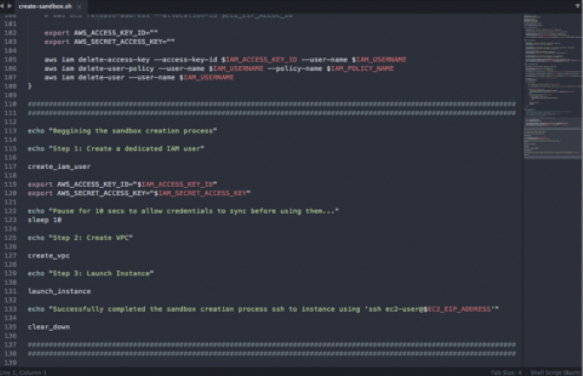
Write a script?
What happens if an API call fails?
How do I roll back?
How do I make updates?
How do I know a resource is ready?

Slide 9
Resource Provisioning Engines
Infrastructure as Code
Desired State Configuration
Create
Update
Delete
diff
CloudFormation Template
JSON/YAML
AWS
CloudFormation

Slide 10
YAML Developer
Certified
100% expert at indentation issues
I don’t like VPCs anymore
Notes:
Show https://github.com/aws-quickstart/quickstart-aws-vpc/blob/master/templates/aws-vpc.template

Slide 11
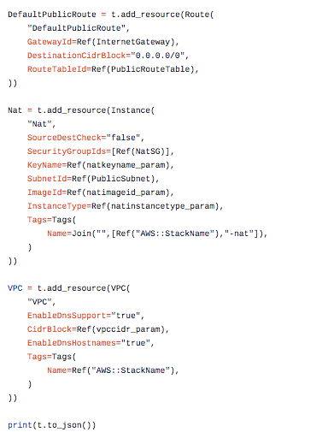
CloudFormation DOMs
Troposphere (Python)
SparkleFormation (Ruby)
CFN-DSL (Ruby)
goformation (Go)
…
REAL CODE ❤️ : “if” statements, for loops
Language-specific
Stay at the CloudFormation abstraction level

Slide 12
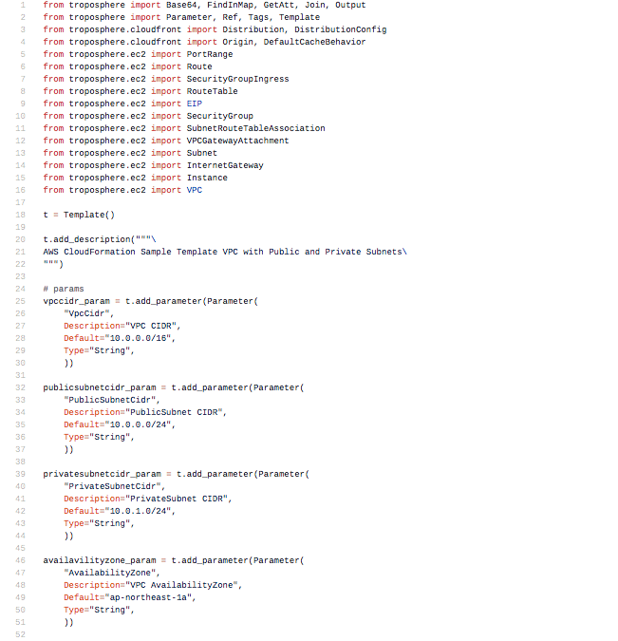
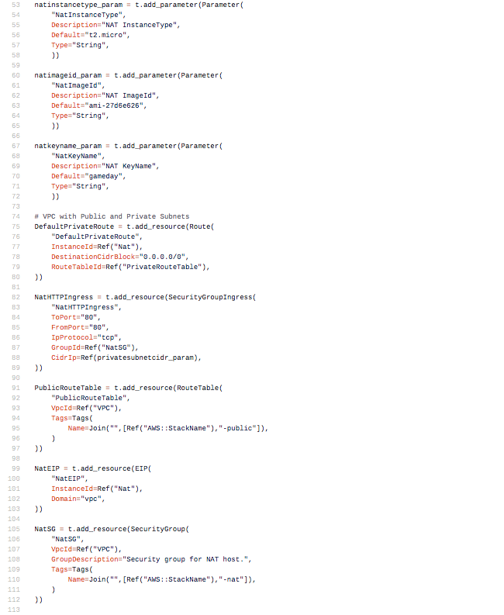
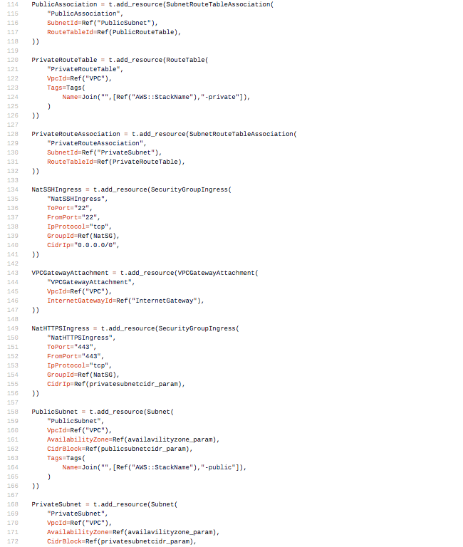
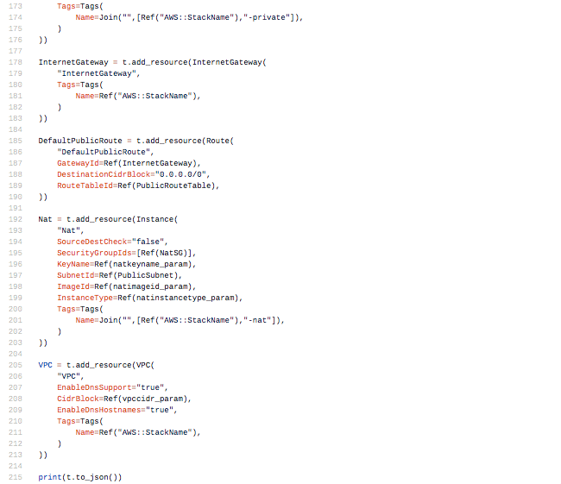
CloudFormation Abstraction Level?
Public/Private VPC
With Troposphere
218 lines of Python

Slide 13
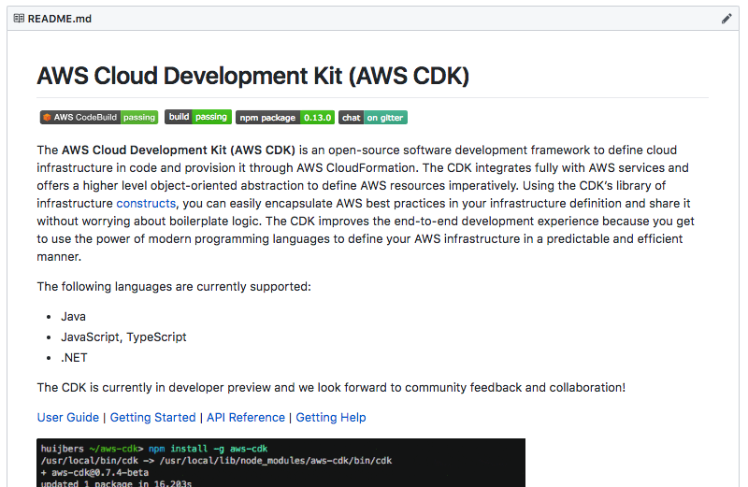
Introducing
AWS Cloud Development Kit
https://github.com/awslabs/aws-cdk

Slide 14
AWS Cloud Development Kit (CDK)
Real code ❤️
Naturally express infrastructure logic
Use familiar tools and workflows
“Compiles” to CloudFormation
CDK apps define the “desired state”
Provisioning is done by CloudFormation
Supports a growing list of programming languages
My app = Infra + runtime
Open source, developer preview
Come build it with us!
Constructs constructs constructs!!!
…

Slide 15
👍 👍 👍 Constructs
Abstract and reusable “cloud components”
Encapsulates infra behind object-oriented APIs
Bundles assets (runtime code, docker images, static files)
Composable (form a tree)
app
stacks
abstractions
resources
resources
resources
resources

Slide 16
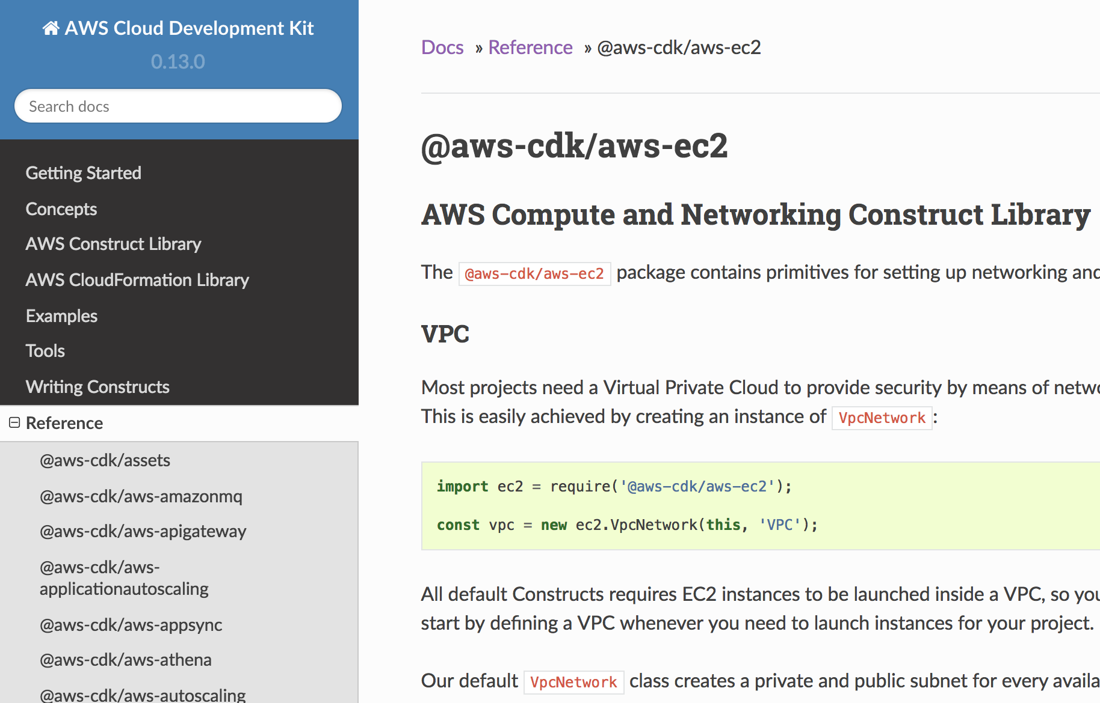
What can we do with constructs?
Modularize your app – organize to modules
Publish your own – share with team/company/community
The AWS Construct Library
Rich object-oriented APIs
Discoverability through IDEs
Implicit IAM permissions
Codifies best practices and HOW TOs
Smart defaults

Slide 17
back to our VPC example…
Notes:
Quick demo: new ec2.VpcNetwork(), synth

Slide 18
Let’s take it for a spin!
https://cdkworkshop.com

Slide 19
In this workshop…
You’ll need:
Laptop
AWS account for experimentation
Basic coding skills
Chapters:
Setup your environment
Create a project
Hello, CDK! (APIGW + Lambda)
Write your own construct
Use a construct library
Get started at
https://cdkworkshop.com
Wifi: Guest/Cube@11999

Slide 20
Debrief
Get started quickly: cdk init
Dev workflow: code => synth/diff => deploy
The AWS Constructs Library: discover in CDK User Guide
Writing your own constructs (HitCounter)
Consuming published constructs (TableViewer)
Questions?

Slide 21
benisrae@amazon.com
Twitter: @emeshbi
Slides: http://bit.ly/cdk-workshop-tlv28
Workshop: https://cdkworkshop.com
Home Page: https://awslabs.github.io/aws-cdk
GitHub: https://github.com/awslabs/aws-cdk
Gitter: https://gitter.im/aws-cdk

Slide 22
GAME DAY PUT YOUR SKILLS TO THE TEST OCT 24 Register now: bit.ly/Floor28GameDay

